Slide 1
LAND DIVING
JONE TRUFERO

Slide 2
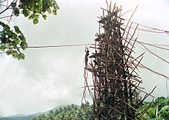
It’s a ritual that men do in the southern part of Pentecost Island, Vanuatu.

Slide 3
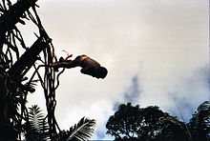
Men jump out of wooden towers that are 66-98 ft high with some vines around the ankles.

Slide 4
The origin is from a legend of a woman that was dissatisfied with her housband.
She runned out to the forest and her housband folloed her.
She climbed a tree and tied lianas to her ankles and jumped out so she survived and her housband did the same but without lianas so he died.

Slide 5
They build the tower during the dry season and the lianas have more elasticity in this season too.

Slide 6
The women are not allowed to go near the tower.

Slide 7
The men are not allowed to wear any lucky charms during the dive.

